Slide 1
Scams & Fraud
Arlington County Police Department

Slide 2
Cyber Safety
Notes:
With more and more purchases being made online these days… cyber safety is important to consider to when trying to decrease your risk of fraud or scams.

Slide 3
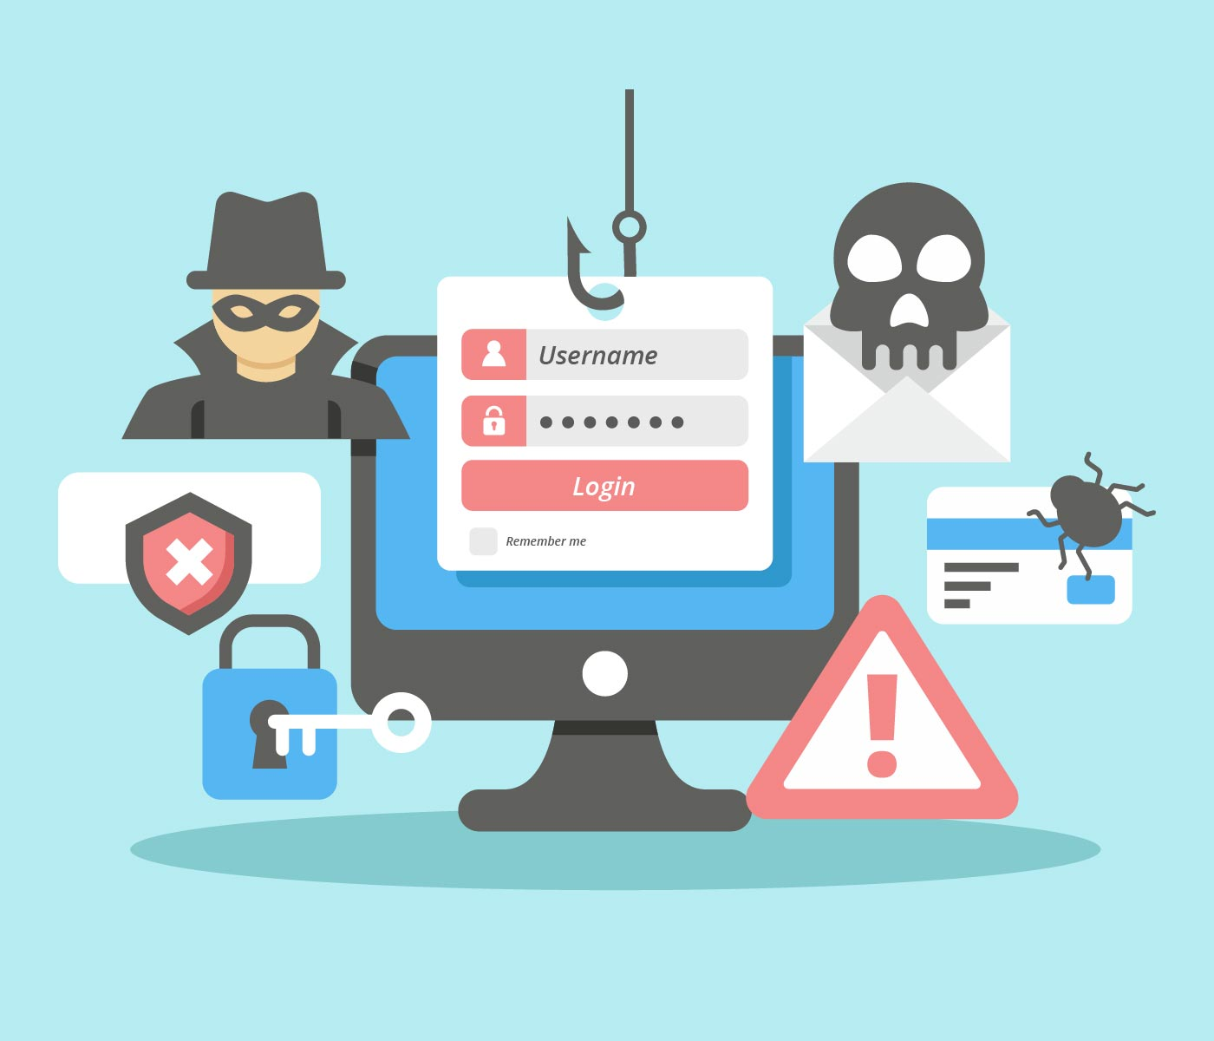
Limit the amount of personal information you post. Do not post information that makes you vulnerable, such as your address, or information about your daily routine or schedule.
The internet is a public resource. Only post what you are comfortable with anyone seeing.
Be wary of strangers. It is easy for people to misrepresent their identities and motives on the internet. Avoid interacting with people you don’t know.

Slide 4
Be
Be skeptical. Don’t believe everything you read online. People may post false or misleading information, and not always with malicious intent.
Evaluate
Evaluate your privacy settings. A site’s default settings may not offer the level of protection you desire and may change, so review your privacy settings regularly.
Use
Use third-party applications cautiously. Third-party applications may provide entertainment or functionality, but avoid enabling suspicious applications and limit the amount of personal information the application can access.

Slide 5
Use strong passwords. Protect your account with passwords that cannot be easily guessed. If your account is compromised, someone else may be able to access your information.
Read privacy policies. Some sites may share your information with other companies, which may lead to an increase in spam. Always read and understand referral policies.

Slide 6
Keep software up to date. Install software updates regularly, including updates to your web browser. This prevents attackers from taking advantage of known problems or vulnerabilities. When possible, enable automatic updates.
Use anti-virus software. When kept up-to-date, anti-virus software protects your computer against known viruses, and can detect and remove viruses before they do damage.

Slide 7
Protecting Your Child on Social Media

Slide 8
Identity Theft

Slide 9
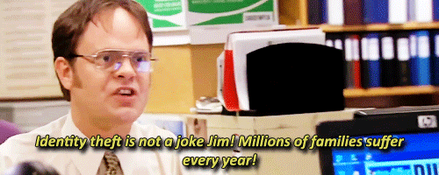
Reduce Your Identity Theft Risk
Don’t list extra information on your personal checks, such as your Social Security Number, driver’s license number or middle name.
Have new checks delivered to your financial institution instead of your home mailbox.
Reduce the number of credit cards you use to a bare minimum and carry as few with you as possible.
Cancel all unused accounts — credit reports still record these, making them susceptible to identity theft.
Keep a record of all your credit cards, account numbers, expiration dates and your card issuers’ customer service and fraud investigation phone numbers. Keep this information in a secure place (not your wallet or purse) so you can quickly contact your creditors if your cards become lost or stolen. Do the same with bank accounts.
Never give your credit card number or other personal information over the phone, unless you have a relationship with the company and you have initiated the call. Identity thieves often call potential victims with a fake story offering prizes or credit, then ask for credit card or bank information to “verify” the award.
Always take credit card and ATM receipts with you instead of tossing them in a public trash container. Shred receipts, account statements and any other personal financial information before discarding them in the garbage.
Order your credit report once a year from each of the three credit bureaus below to check for inaccuracies and fraudulent use of your accounts.
Notes:
Credit for the picture: The Office

Slide 10
Credit Bureaus
Equifax Information Services, LLC: 800-525-6285
Experian (TRW): 888-397-3742
TransUnion: 800-680-7289

Slide 11
Report Identity Theft
Arlington County Police Department: 703-558-2222
Federal Trade Commission’s toll-free hotline: 877-438-4338

Slide 12
Fraud

Slide 13
General Tips
Be suspicious of:
Strangers who are overly friendly or who offer to share “just-found money”
Someone claiming to be a “bank examiner” who requests your help in catching a thief — a real bank official won’t ask you to take money out of your account for any reason
The well-dressed “bank official” or uniformed “guard” who offers to make your bank transactions for you
Phony debts after the death of a loved one — check it out before paying
Getting something for nothing and deals that sound too good to be true
“Free home inspection” offers or door-to-door solicitations for home improvements
Stop and think before you hand anybody any cash.
Read and understand anything you sign, especially the fine print.
Report to the police any crime, attempted crime or suspicious person or activity. If you have any doubts about something, report it — you may prevent a crime.

Slide 14
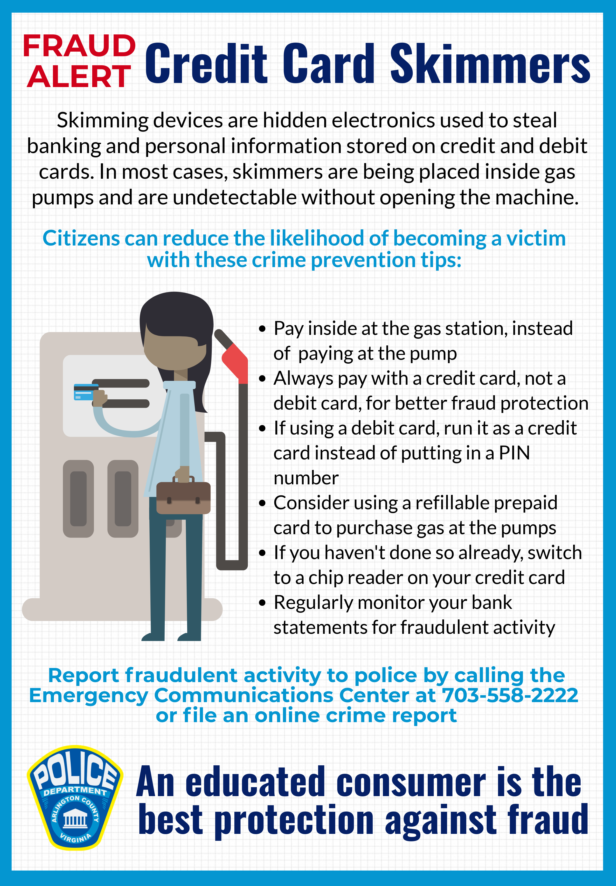
Credit Card Skimmers
Credit card skimming cases are typically reported to police as credit card fraud. Since credit and debit cards are accepted at most locations, the challenge is identifying the point of compromise. Turnaround time from point of compromise to first fraudulent use varies depending on how the suspects intend to use the stolen data. Police work closely with banking institutes who notify us when there is a trend with customers cards being compromised and they identify the location all the cards have in common. Citizens are encouraged to regularly review their bank statements and report fraudulent activity.

Slide 15
Consumer Fraud
Beware of the smooth-talking salesman who comes to your home unannounced. Also, be weary of any phone call requesting a home appointment to give you something or asking you to participate in a survey.
Be on the alert for the operator who poses as an inspector. If you’re approached in this way, ask for the person’s credentials and call the agency represented or the Arlington County Police Department (ACPD) at 703-558-2222.
Watch out for bait-and-switch sales tactics. This is when a merchant advertises a product at a certain price or as possessing certain qualities, but when you attempt to buy it, you’re switched to a higher-priced or off-brand product.
Fight the temptation of referral selling. This scheme offers you the chance to make quick money by supplying your friends and relatives’ names as prospective customers.
Carefully investigate “free” or “bargain” offers. There is often a hidden trick or condition attached to the offer, which may result in you paying much more.
Don’t be rushed into signing any papers. Carefully read, examine and understand all conditions of any contract or agreements. Never sign a blank contract or a contract with blank spaces.
Don’t rely on verbal representations. Be sure that such promises can be found in the terms and conditions.
Ask questions. Know exactly what you’re buying and find out what the product or service will cost.
Know with whom you are dealing. Beware of the fly-by-night operator or the company without a local address. It’s safer to deal with a local merchant you know.
Don’t hesitate to shop around. You may find a better price for the same product elsewhere.

Slide 16
Credit Cards
Never give your credit card number over the telephone to unsolicited callers.
Don’t put your account number on the outside of envelopes when making monthly payments.
Keep your credit card number confidential —it represents your money.
Report a lost or stolen credit card by calling the card issuer’s toll-free phone number. To limit your liability from unauthorized charges, follow the card issuer’s instructions explicitly.

Slide 17
Contracts
When signing a contract, agree to the printed terms in the contract, not to verbal representations.
Always keep a copy of what you sign.
Have all the blanks in the contract filled in before you sign it.
Understand the contract before you sign it. Generally, there is no “buyer’s right to cancel” clause in contracts signed at a company’s place of business.
Be suspicious of anyone who won’t let you take a copy of a proposed contract or agreement to someone you trust before you sign. Call the Consumer Protection Hotline – Handled by the Office of the Attorney General, VA toll free at 800-552-9963 or at 804-786-2042 for suggestions.
Don’t accept the seller’s word that any part of a contract doesn’t apply to you (unless that part is crossed out on all copies and initials) or that something not listed will be done unless it is written in before you sign.

Slide 18
Scams

Slide 19
Senior Scams (Why targeted?)
Vulnerability & Loneliness:
they spend hours talking to potential victims
They first try to get a small contribution and establish a trusting relationship
Declining Health:
Makes it difficult to leave house & deprives them of their ability to perform simple household repairs. This makes the offer of chores preformed difficult to resist.
Declining mental health (Alzheimer’s disease)or another ailment may make it difficult to remember whether they agreed to make a particular investment or to send a check for a cause.
Accessibility:
Being retired or suffering from physical problems, seniors are the group of people most likely to be at home to receive a telemarketer’s call or visit from a door to door salesman.
Isolation:
An increasingly sad fact of life for seniors
Loneliness can sometimes can sometimes cause them to reach out to telemarketers for company
Seniors may not have regular contact with relatives and friends to discuss prospective investment schemes or financial affairs.

Slide 20
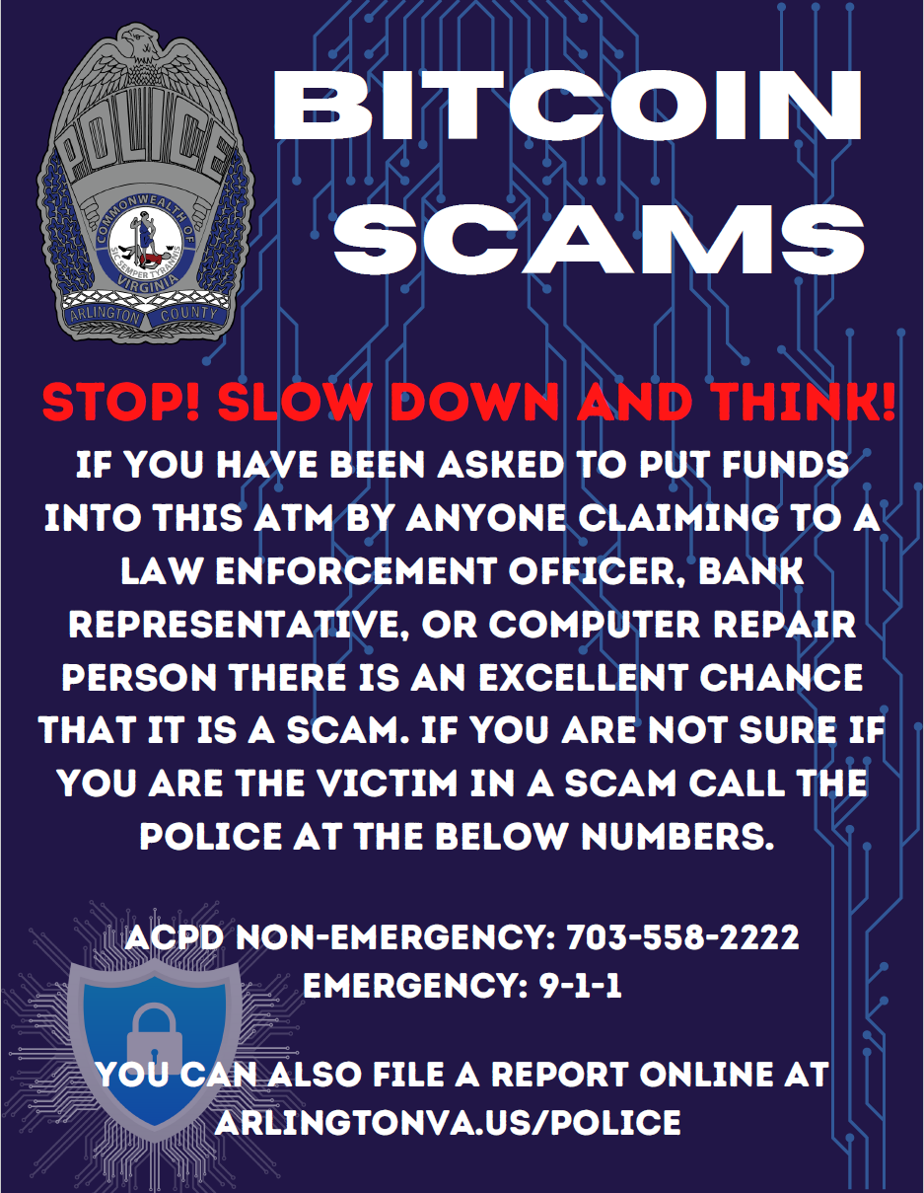
STOP! SLOW DOWN AND THINK!
Scammers often pretend authority figures, suck as members of law enforcement or bank employees. Scammers may give you Bitcoin as an option to pay off a credit or a warrant.
To ensure legitimacy, explain that you will call them back once you have determined how to pay them. Once off the phone with the potential scammer, call your bank directly and inquire.
Arlington County Police Department and Sheriff’s Office does not allow you to pay off “warrants.” This should be a easy red flag to spot. If you want to see if you have warrants under your name, you can all the police department to verify.
ACPD has placed one of the flyers seen to the left on every bitcoin machine known to us in the county as a reminder to slow down before sending unverified money to unconfirmed individuals.

Slide 21
Home Repairs
Shop around — get estimates from at least three contractors and check with people who had work performed by them. Call the Consumer Protection Hotline – Handled by the Office of the Attorney General, VA toll free at 800-552-9963 or at 804-786-2042 to determine if there are any complaints against the contractors.
Before you sign the contract, make sure you understand the contract and that it includes the following information:
A description and total cost of the services to be performed
Types of materials to be used
Start and completion dates
Warranty information, if applicable
Be cautious of companies that require advanced payments.
Remember that the cheapest bid may not always be the best.
Learn more about the home repair/improvement permit process in Arlington by visiting the Building Arlington Website or call the Arlington County Building Inspection Division at 703-228-3800.
The County requires all home improvement contractors to be licensed and to show prospective customers a County-issued identification card on request. This includes installers of:
Aluminum or other siding
Concrete work
Structural changes
Doors
Fences
Fire damage repairs
Kitchen and bathroom remodeling
Masonry
Roofing
Swimming pools
Waterproofing
Note: This licensing requirement doesn’t apply to landscapers or painters (except when the paint is to be applied to a roof or asphalt paving), or to licensed electricians, gas fitters or plumbers (who are licensed under a different provision of the Code). For more information, call the Arlington County Building Inspection Division at 703-228-3800, or the Office of the Attorney General, VA Consumer Protection Hotline toll free at 800-552-9963 or at 804-786-2042.

Slide 22
Door-to-Door Sales
Be suspicious of a solicitor who says, “You’ve been selected …” or “I’m taking a survey.”
Ask to see the solicitor’s identification and company credentials, including a County Solicitor’s License. The County requires all door-to-door salespersons to be licensed and to show prospective customers a County-issued identification card on request.
Buy only if you need the item, not because you may feel sorry for the solicitor.
Insist on a written guarantee.
Take ample time to consider the purchase. Avoid any high-pressure tactics.
Never sign a contract unless you completely understand it and know the total cost.
Note: Virginia state law provides a buyer of most consumer goods and services with three days to cancel a home solicitation sale after a purchase. If a “Buyer’s Right to Cancel” clause is not included in the contract and the company won’t accept a written cancellation, call the Consumer Protection Hotline – Handled by the Office of the Attorney General, VA toll free at 800-552-9963 or at 804-786-2042.

Slide 23
Telemarketing
To avoid a telemarketing scheme, tell the caller you’re not interested and/or just hang up the phone.
Never give a telemarketer your credit card number, bank account number or Social Security Number, or authorize bank drafts.
When listening to a sales pitch, remember the federal government’s Telemarketing Sales Rules:
You must be told the name of the company, the fact that it’s a sales call and what’s being sold.
If there’s a prize offering, you must be told immediately that there’s no purchase necessary to win, and you can’t be asked to pay anything for it. You can’t even be required to pay shipping charges. If it’s a sweepstakes, the caller must tell you how to enter without making a purchase.
You can’t be asked to pay in advance for services such as cleansing your credit record, finding you a loan or acquiring a prize you’ve supposedly won. You pay for services only if they’ve been delivered.
You shouldn’t be called before 8 a.m. or after 9 p.m. If you tell telemarketers not to call again, they can’t. If they do, they’ve broken the law.
If you’re guaranteed a refund, the caller has to tell you all the limitations.
If you suspect fraud, call the National Fraud Information Center at 800-876-7060.

Slide 24
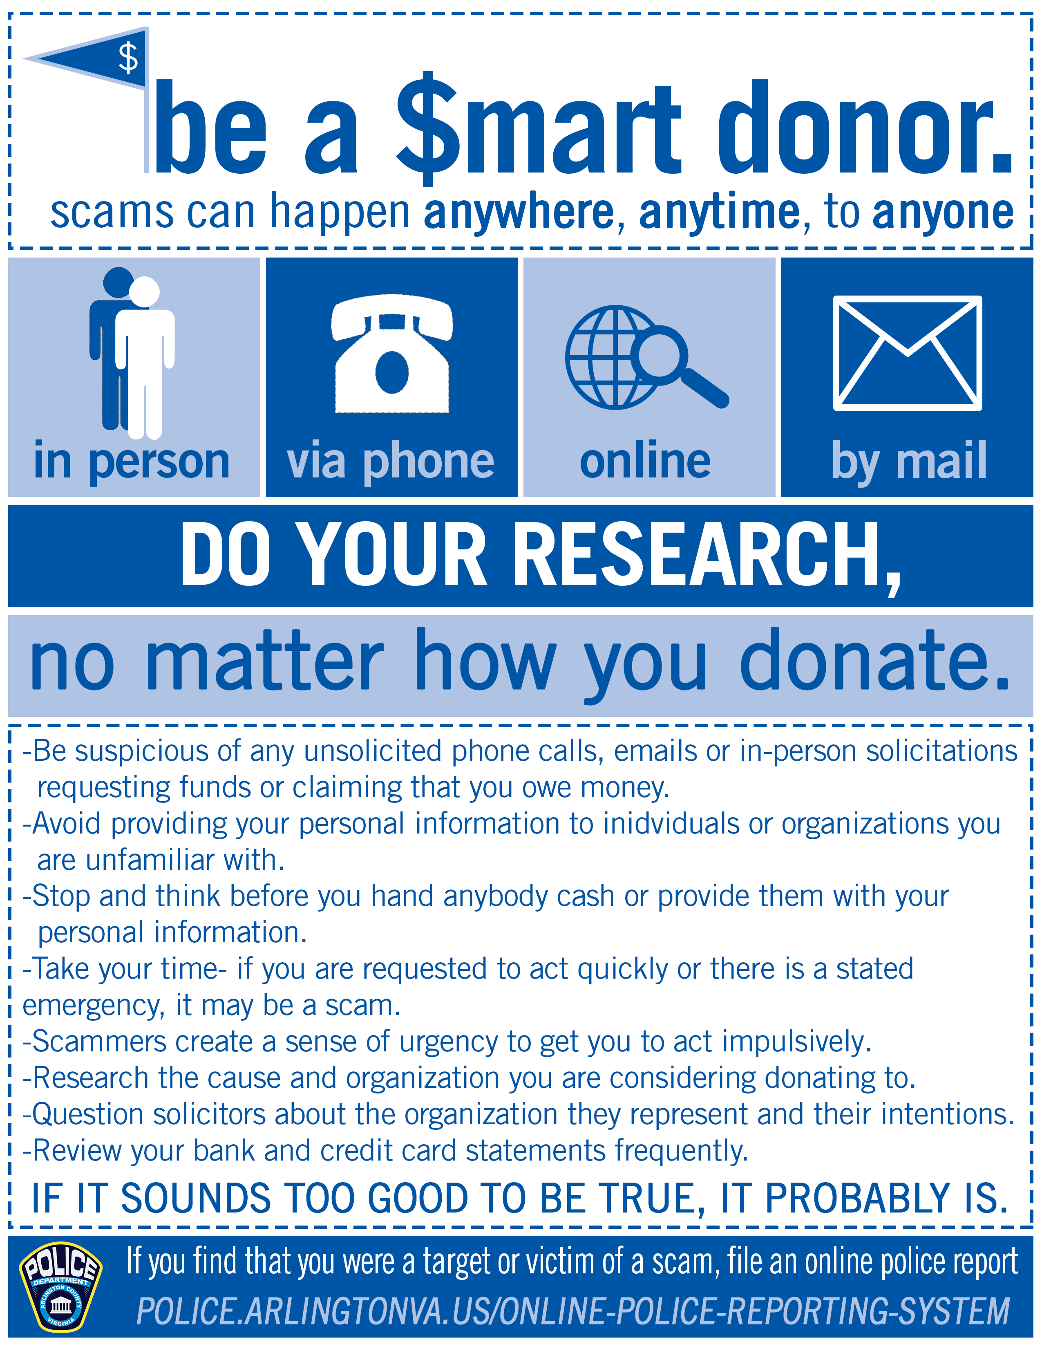
Charitable Solicitations
When approached by a charitable solicitor, follow these practices:
Demand to see the solicitor’s proper identification.
Donate only to familiar causes and organizations.
Check an organization’s reliability by calling the Consumer Protection Hotline – Handled by the Office of the Attorney General, VA toll free at 800-552-9963 or at 804-786-2042.
To find out more about the charitable organization and how much your contribution will be used for charitable purposes, call the Office of Charitable and Regulatory Programs (OCRP) within the Virginia Department of Agriculture and Consumer Services at 804-786-1343. All charitable organizations must be registered with OCRP.

Slide 25
Outstanding Warrant and Jury Duty Scams
Periodically, residents have reported receiving unsolicited phone calls claiming they have failed to appear for jury duty and/or have an outstanding warrant for their arrest. The resident is provided with a phone number and instructed to call an individual the scammer claims to be a Lieutenant with the Arlington County Sheriff’s Office or other local law enforcement agencies. The scammer then demands immediate payment for an alleged fine. Through threats and intimidation, they attempt to convince residents to purchase prepaid credit cards and provide the identification numbers which allows the scammers to obtain the money from the cards.
If you receive a call of this nature, immediately hang up with the caller and verify the claim by calling the Arlington County Sheriff’s Office at 703.228.4460. Never use a phone number provided to you from the caller to verify their credibility.
As a reminder, the Arlington County Police Department and Sheriff’s Office will not call and ask for money over the phone.

Slide 26
Social Security Scam
Calls saying your social security number has been compromised and is now locked.
It is best to just hang up and block the number.
If there is truly something wrong with your SSN, you will receive the information via snail mail.
DO NOT give any personal information.
If they are calling you, they should already have your information.
There is no need to confirm any of your information.

Slide 27
Report a Crime
ACPD asks that the public report applicable non-emergency incidents using the online reporting system. Officers continue to proactively patrol the County and respond to in-progress crimes and emergency calls where there is an immediate threat to life, health or property.
Make an online report:
Online Police Reporting System - Police (arlingtonva.us)
Call the non-emergency number: 703-558-2222.
In an emergency call 9-1-1.
Notes:
Remember: You have the most information on your case. With an online report, you can be as detailed as possible with your own case. Goes direct to detectives and gives you an automatic temporary case number. You can edit the report at any time.

Slide 28
Questions?

